Slide 1
THG Simulations
Project update
Week 7
29/08/2023
David Amorim

Slide 2
Overview
Work done since last week:
Finished code handover document (set meeting for this Friday?)
Set up code to use for manuscript plots
Work left to do:
Produce plots for manuscript with the improved COMSOL model (for both the new and the 2019 cell)
Write presentation and report (based on manuscript plots)
This presentation:
Showing preliminary sample plots for the manuscript, produced using the old density models
Produced only for Argon; for manuscript: do Argon and Neon (?)
Please give feedback on anything to be changed for the plots (e.g. labels, annotations, fontsizes,….)

Slide 3
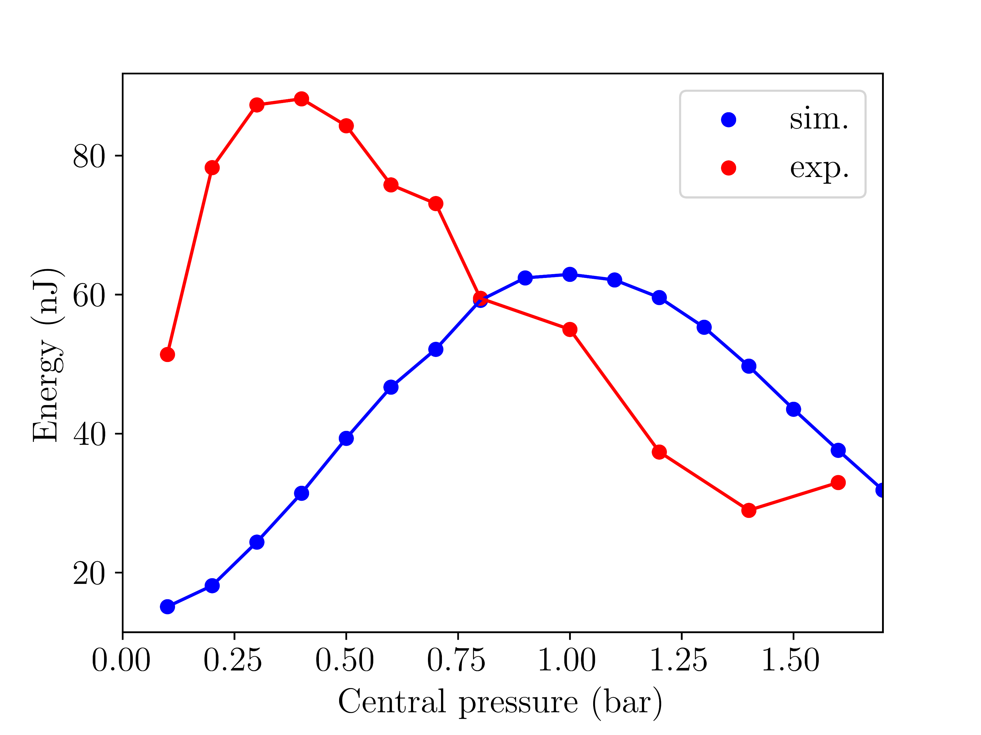
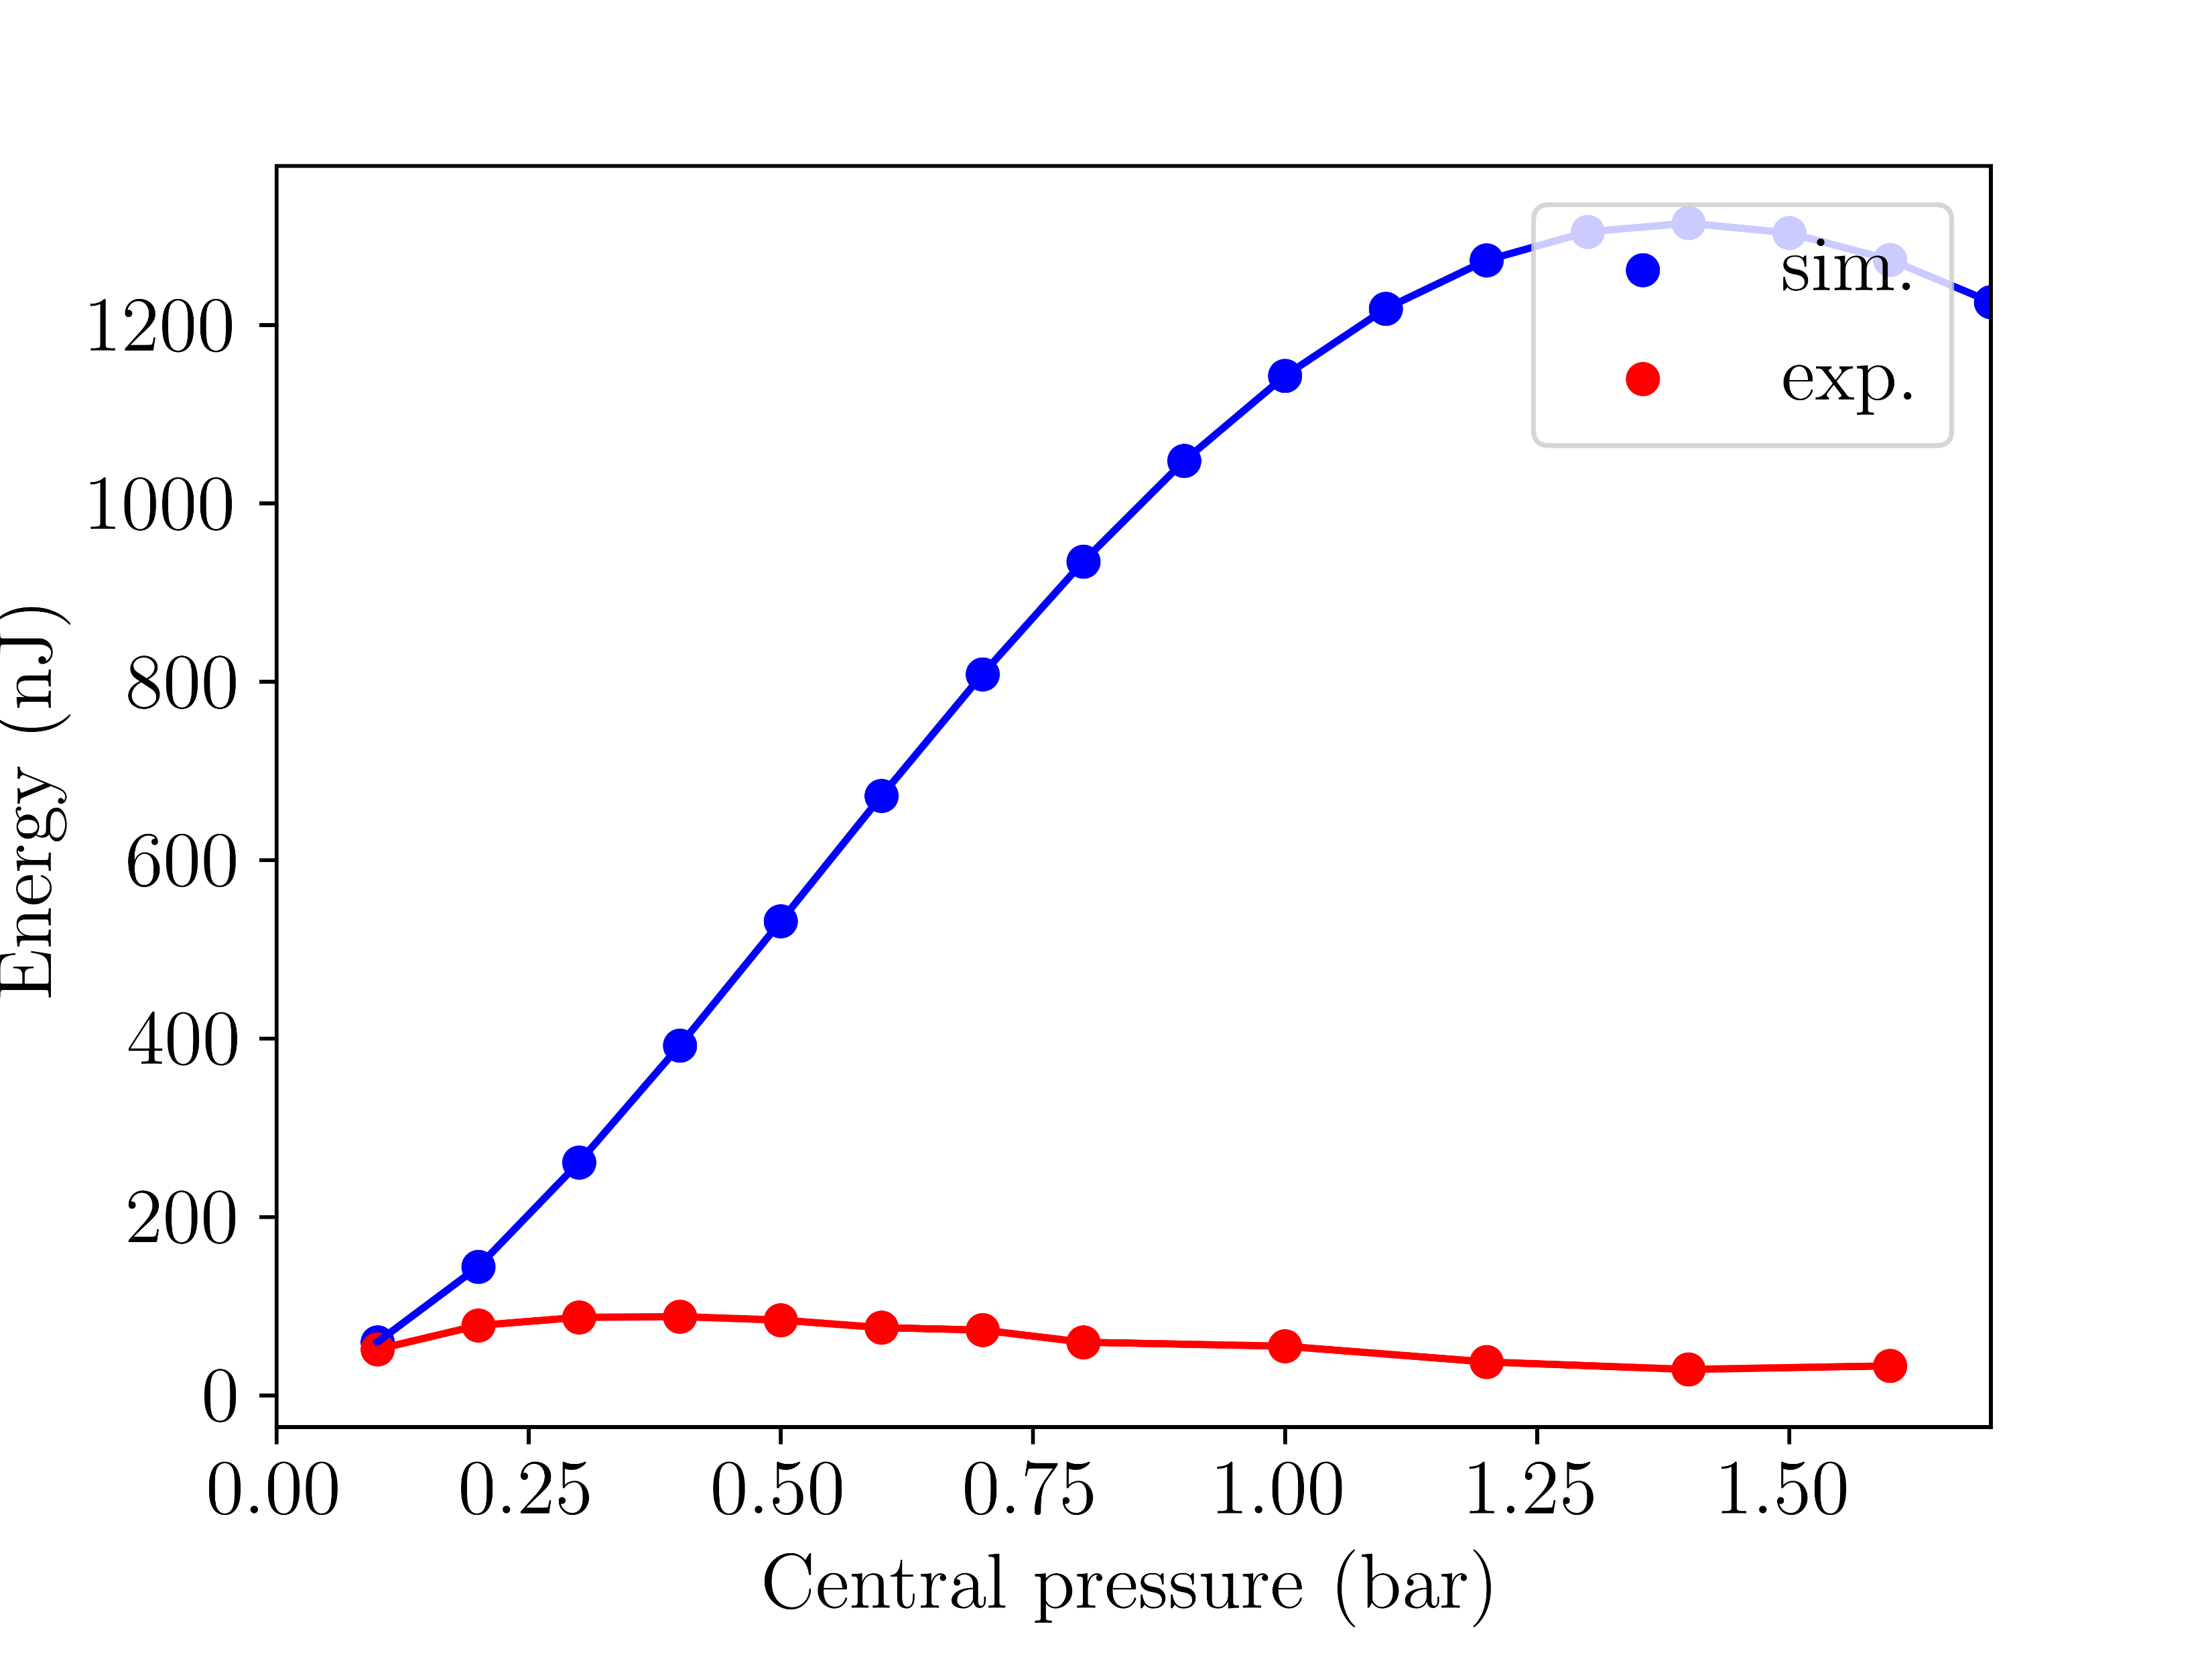
Sample manuscript plots: A. Simulated pressure scan energies
Fig. 1a: Argon at 150mW (simulations with
COMSOL model)
Fig. 1b: Argon at 150mW (simulations with
gradient model)

Slide 4
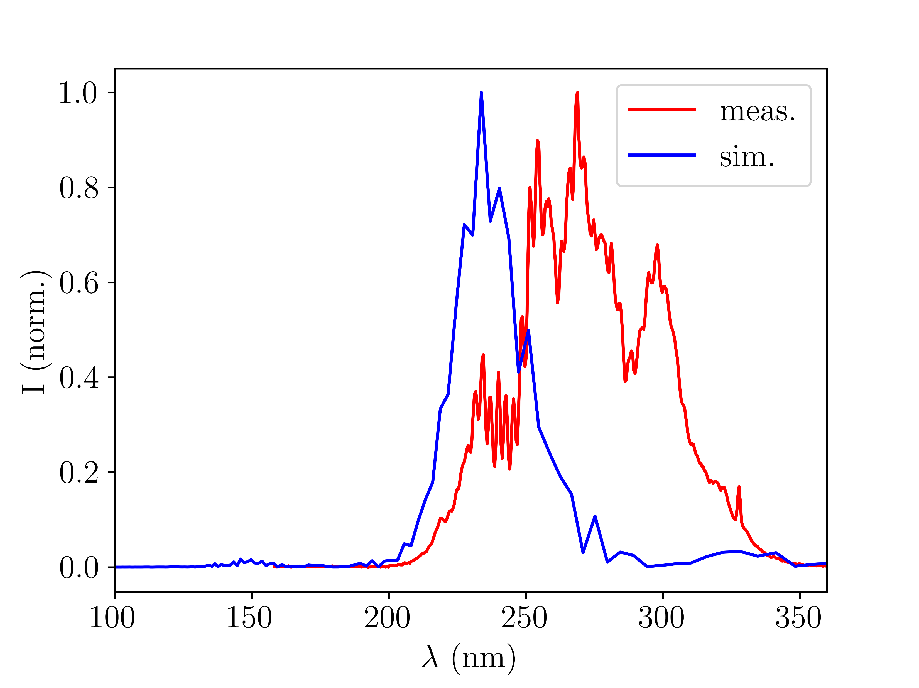
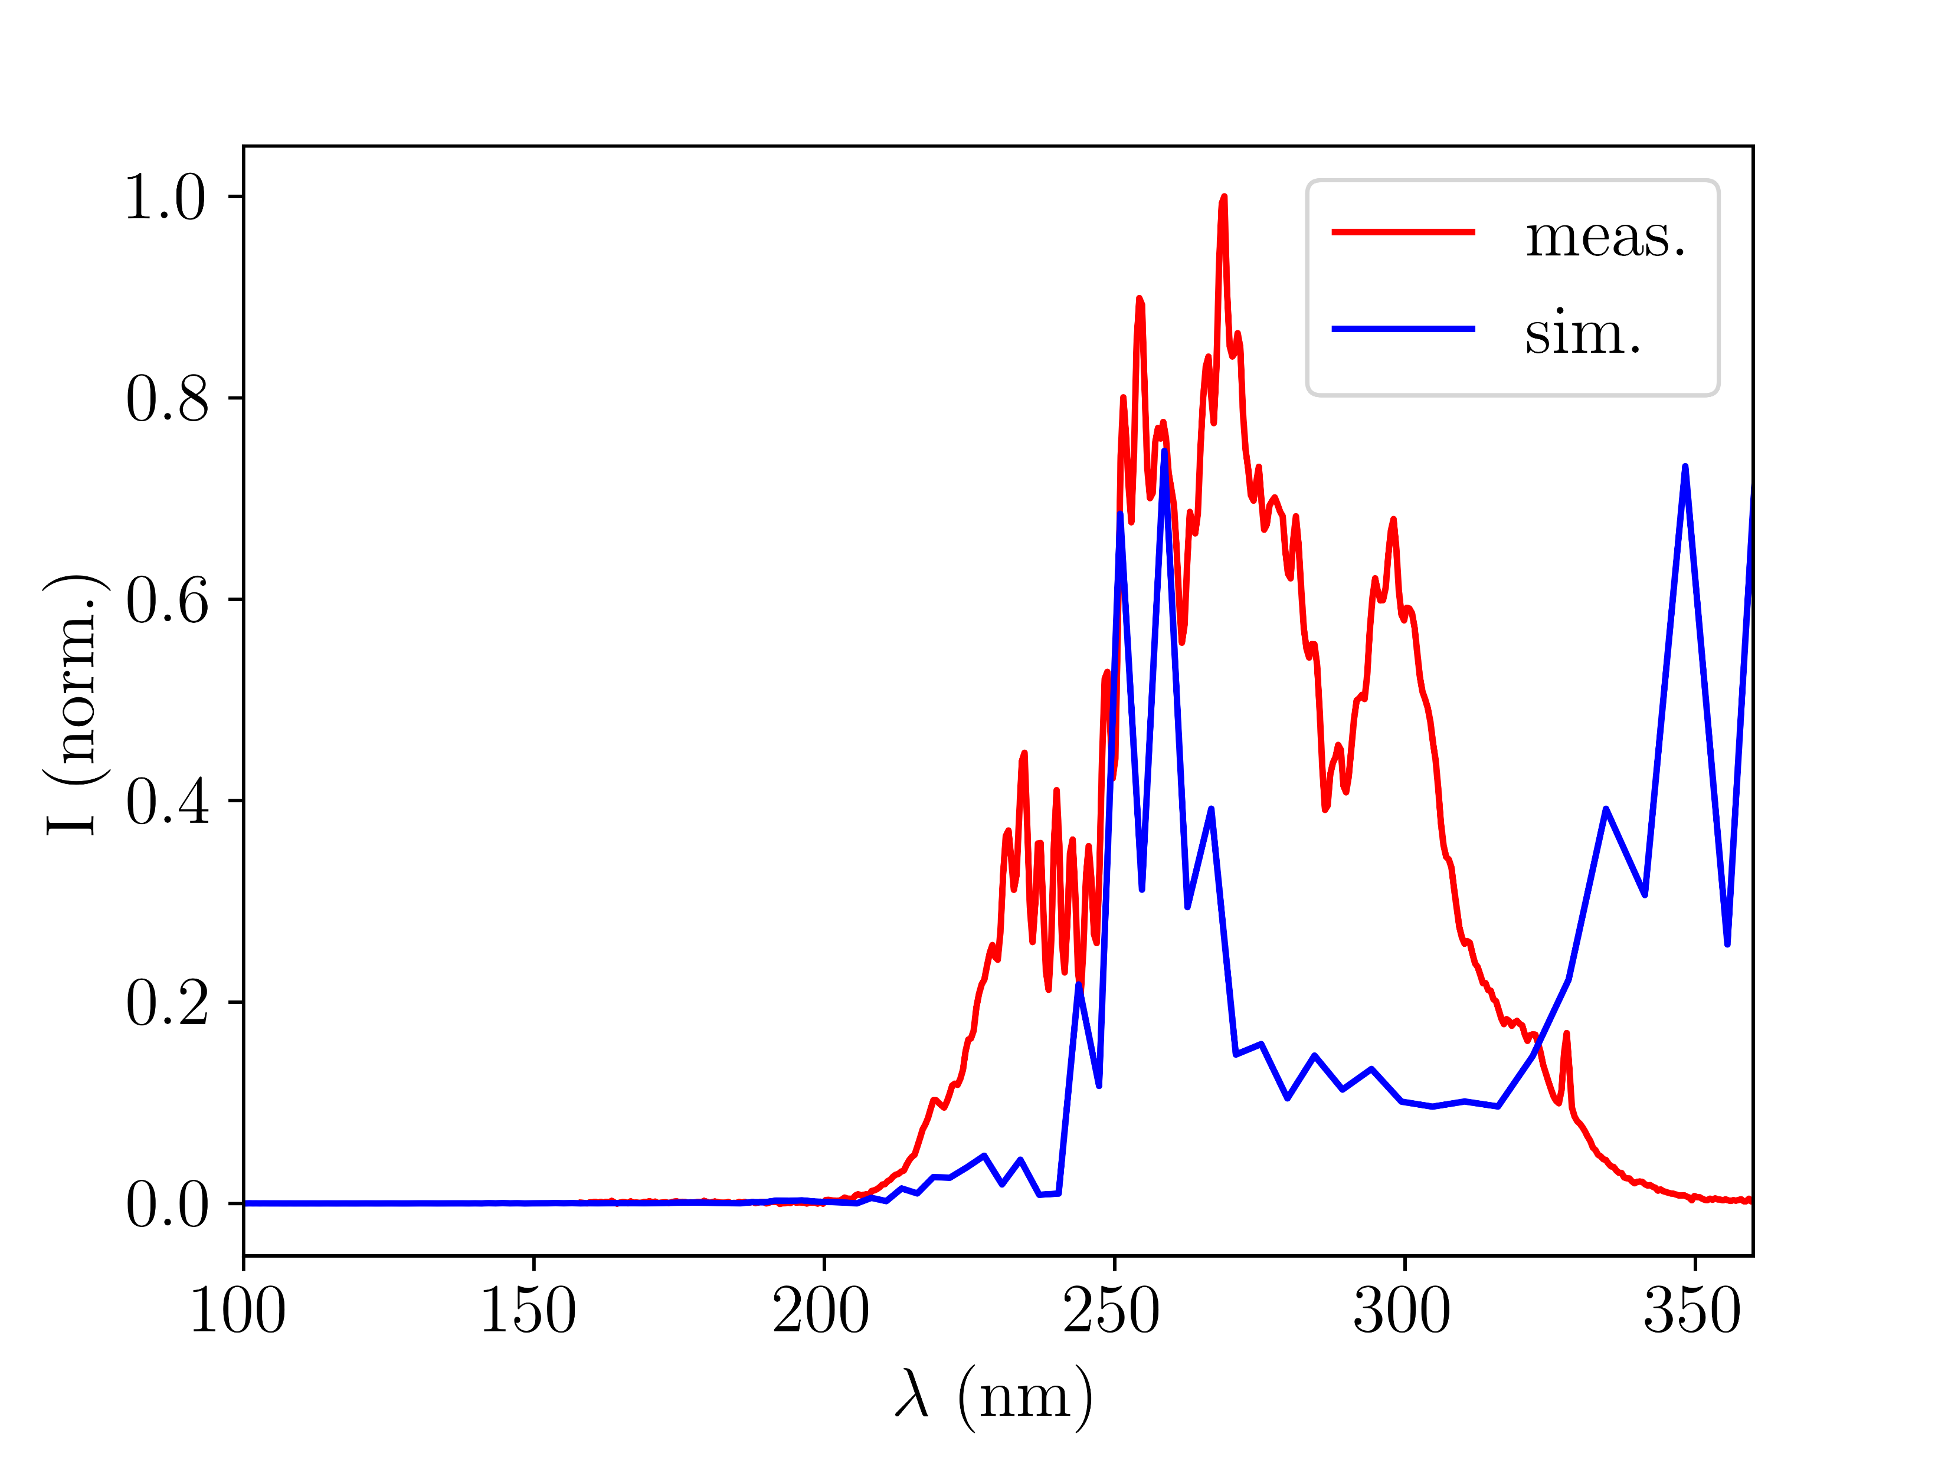
Sample manuscript plots: B. Simulated v. measured UV spectra
Fig. 2a: Argon at 150mW and 0.4bar (simulations with
gradient model)
Fig. 2b: Argon at 150mW and 0.4bar (simulations with
COMSOL model)

Slide 5
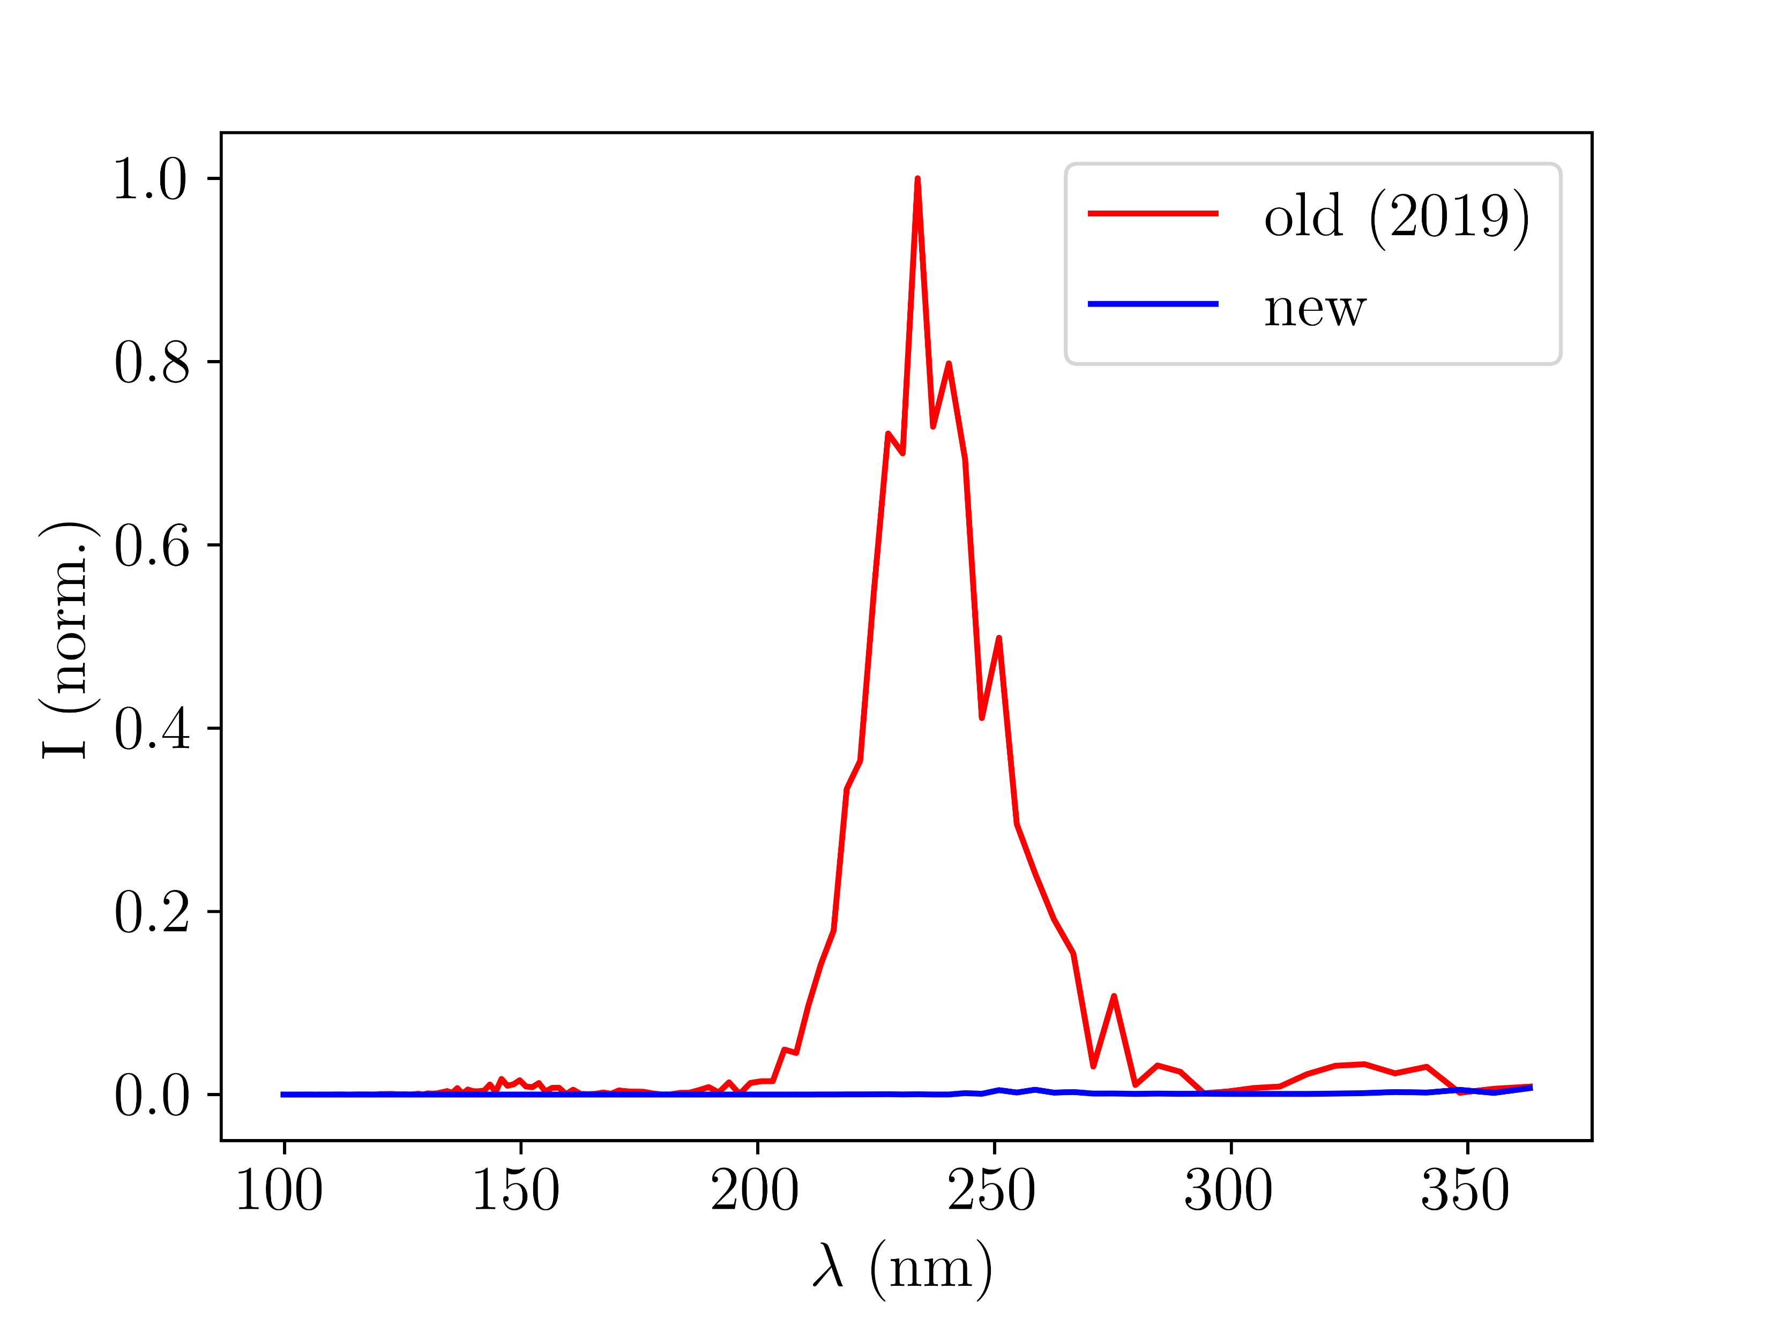
Sample manuscript plots: C. New chip v. old cell
Note: no model of old chip available yet
Fig. 3: Argon at 150mW and 0.4bar (simulations with
gradient model and COMSOL model of new chip)

Slide 6
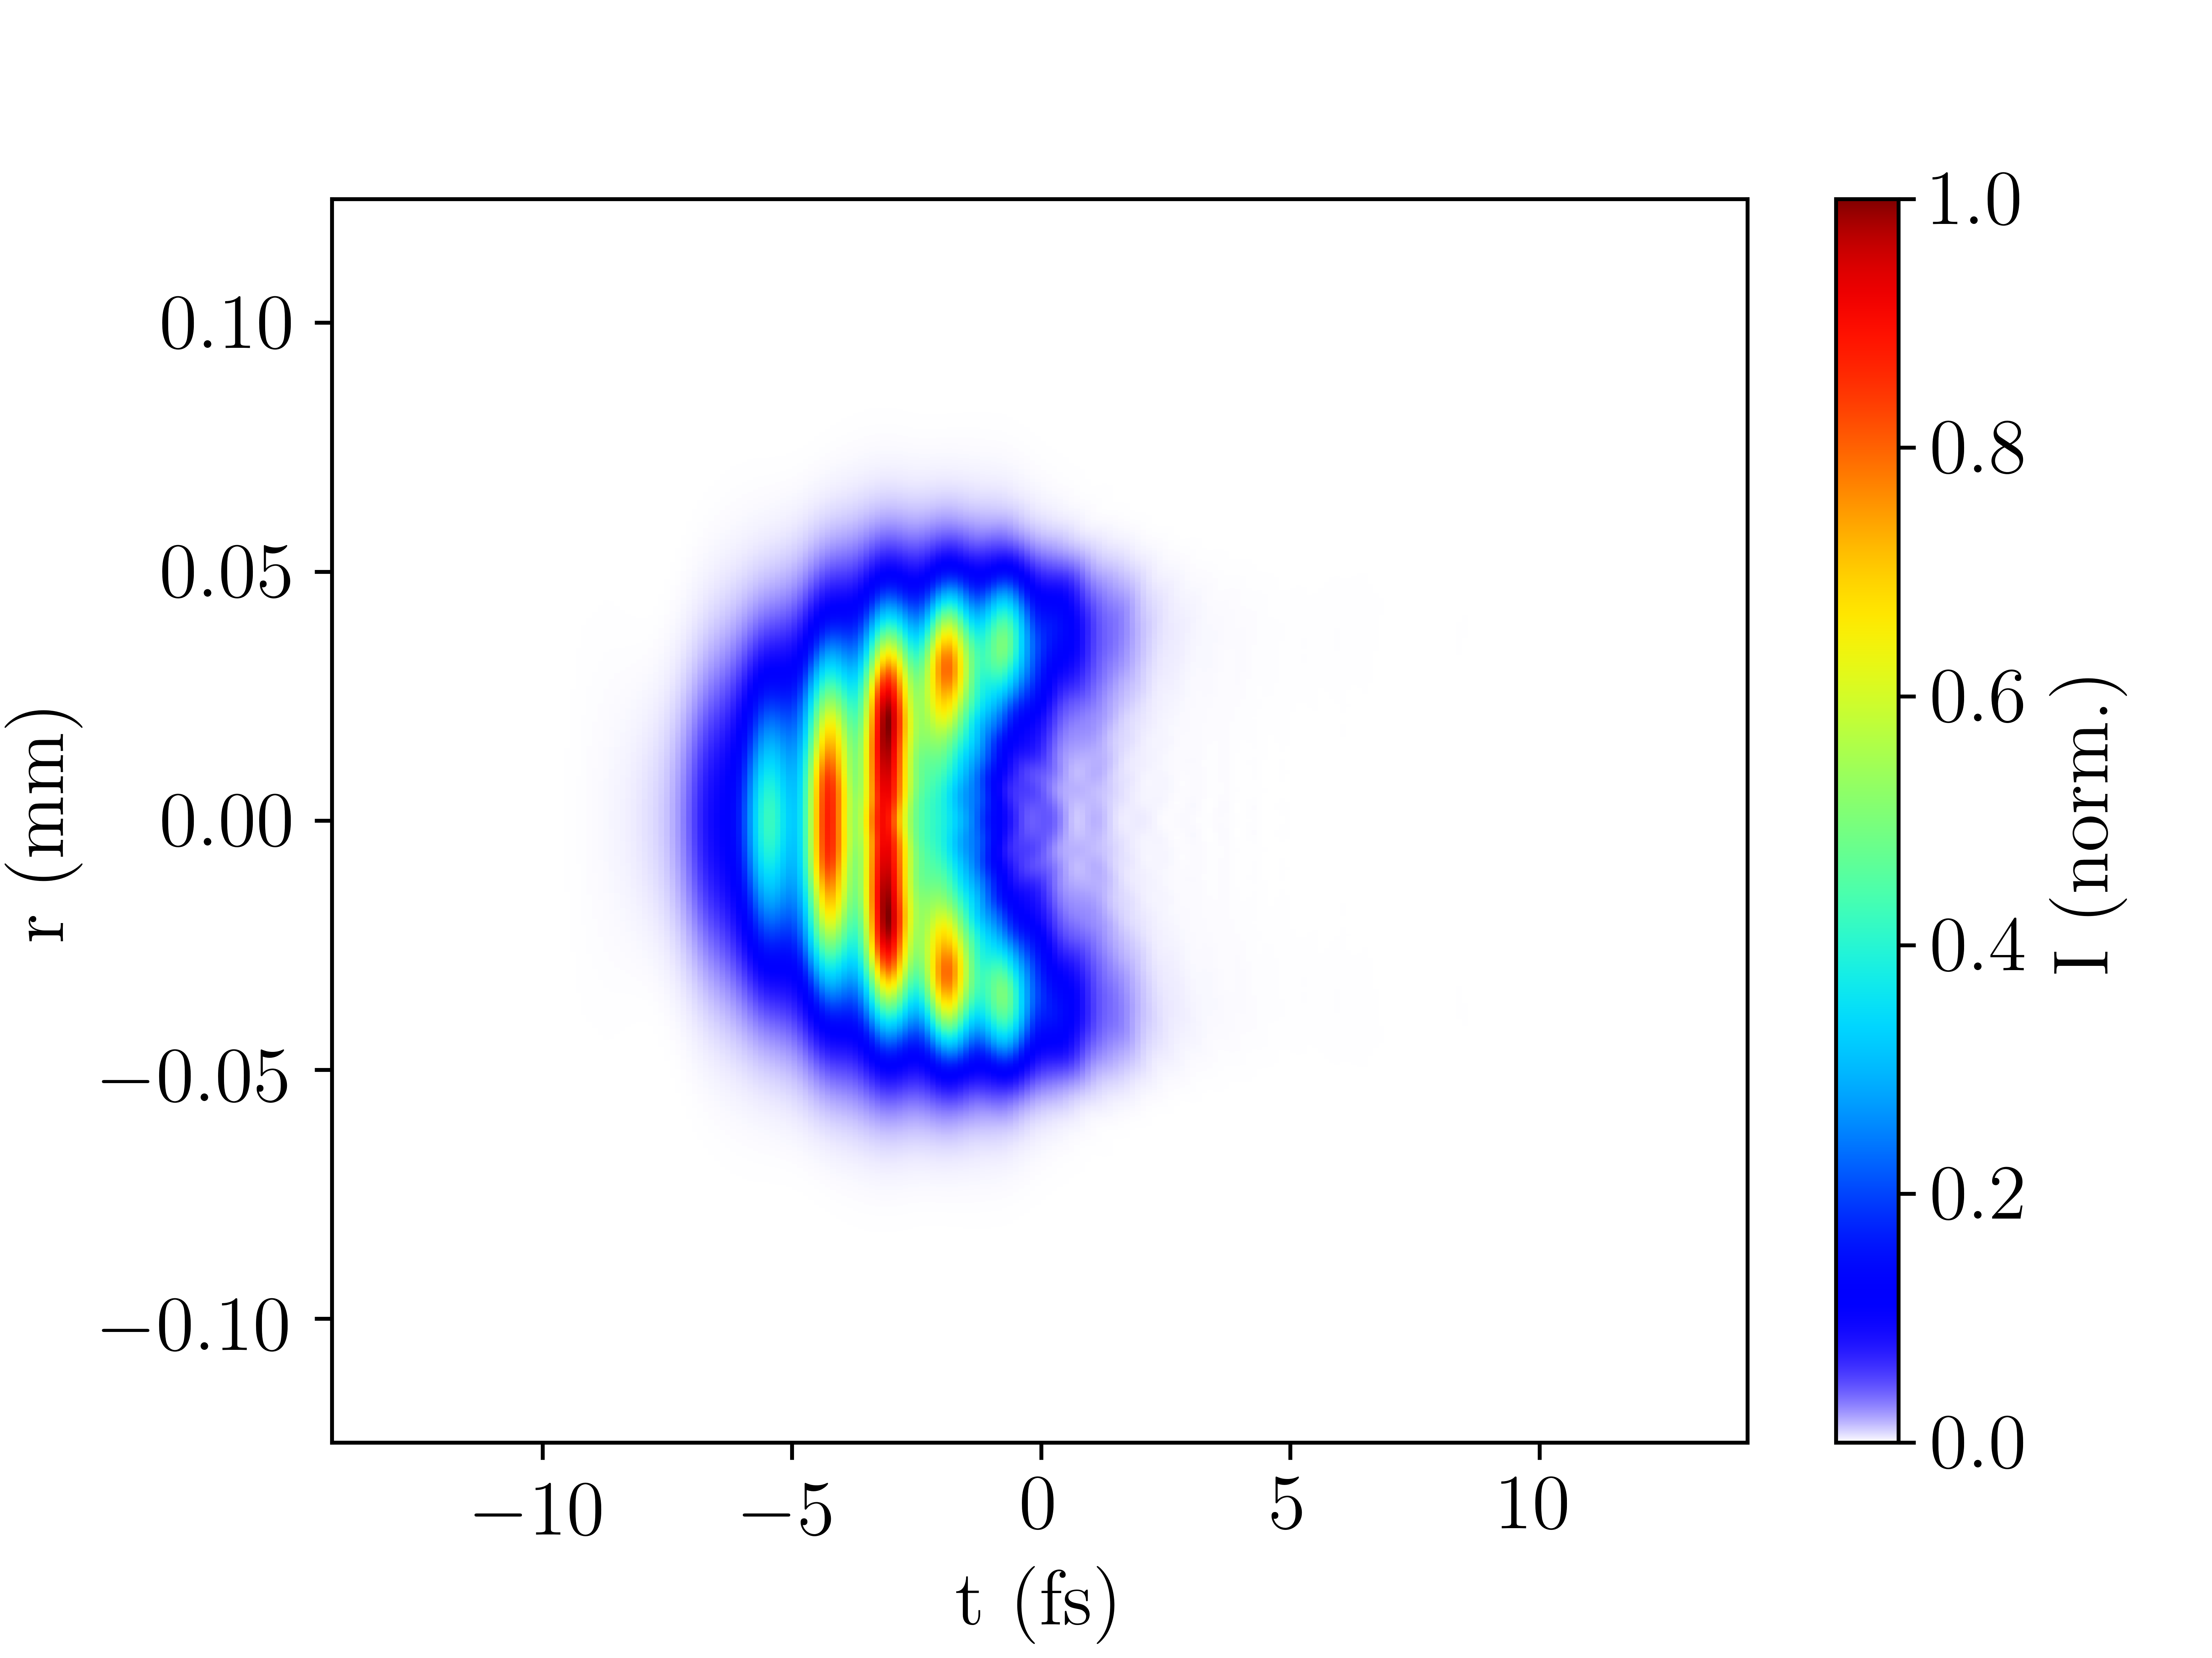
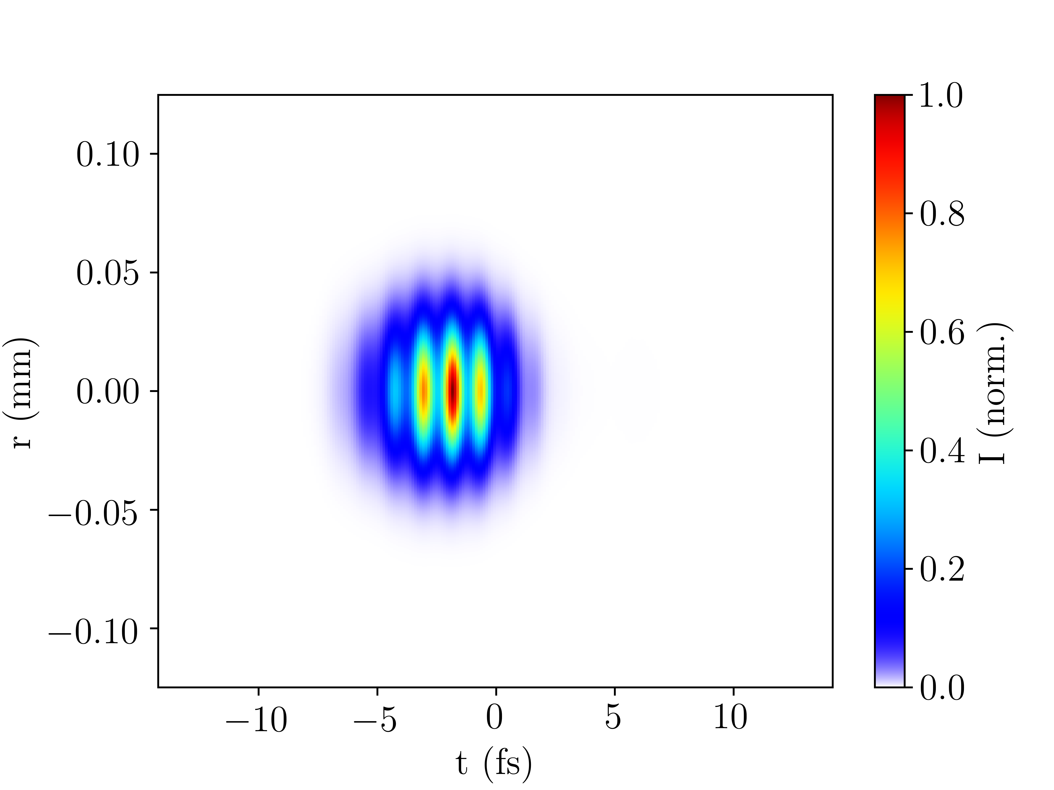
Sample manuscript plots: D. Spatiotemporal UV profile at output
Note: add TL pulse duration as annotation?
(a) with ionisation
(b) without ionisation
Fig. 4: Argon at 150mW and 0.4bar (simulations with
gradient model)

Slide 7
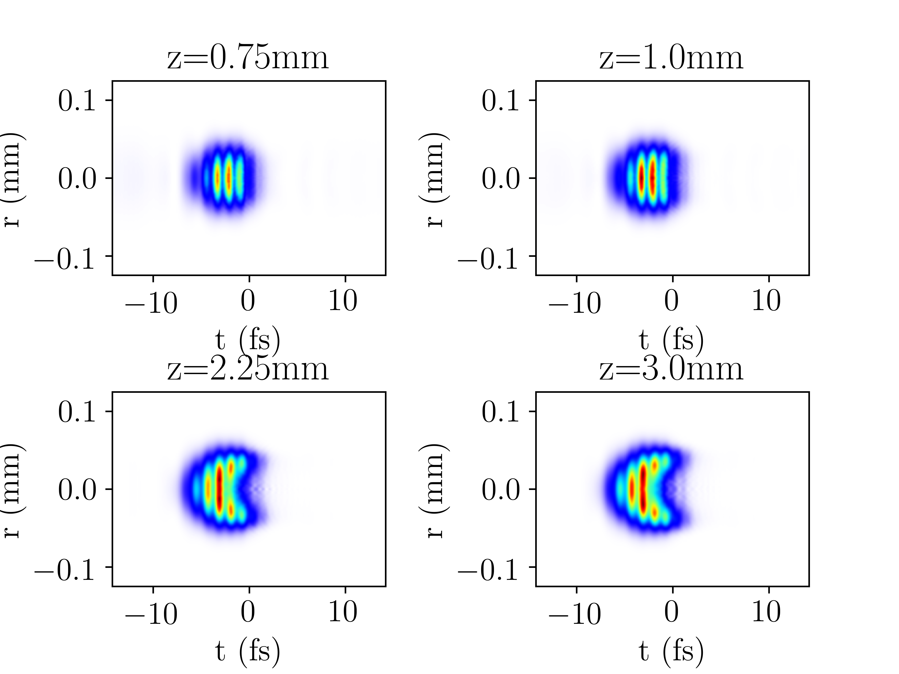
Sample manuscript plots: E. Spatiotemporal UV profile at different positions
Fig. 5: Argon at 150mW and 0.4bar (simulations with
gradient model)

Slide 8
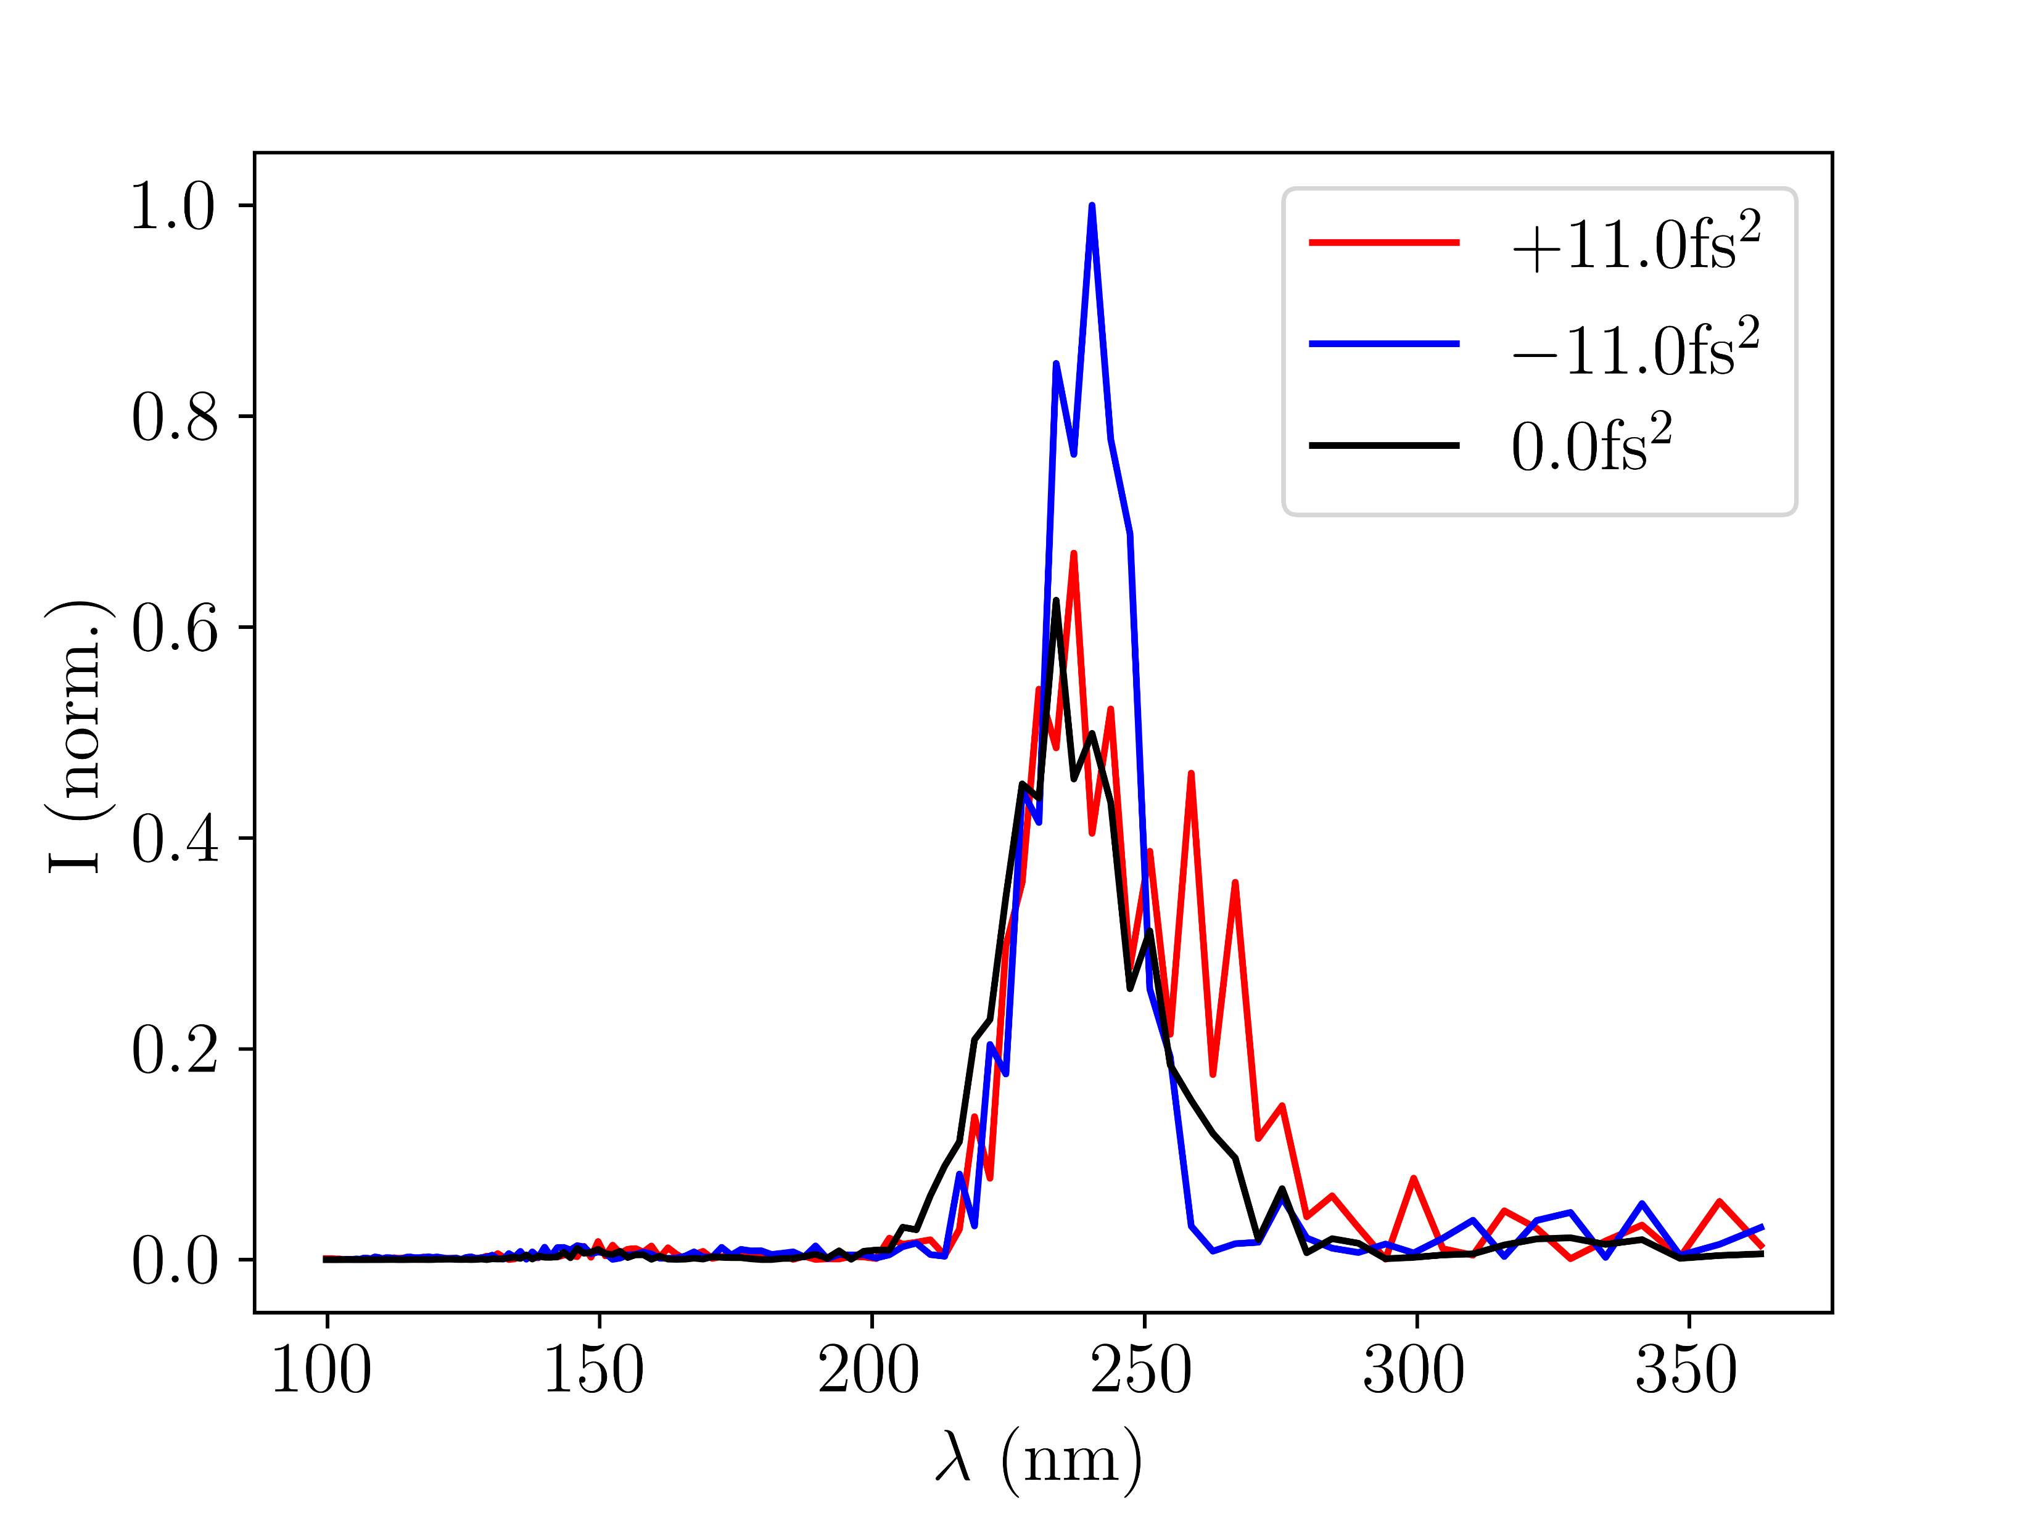
Sample manuscript plots: F. Effects of chirp
Fig. 6: Argon at 150mW and 0.4bar with different
GVD values of the input pulse (simulations with
gradient model)

Slide 9
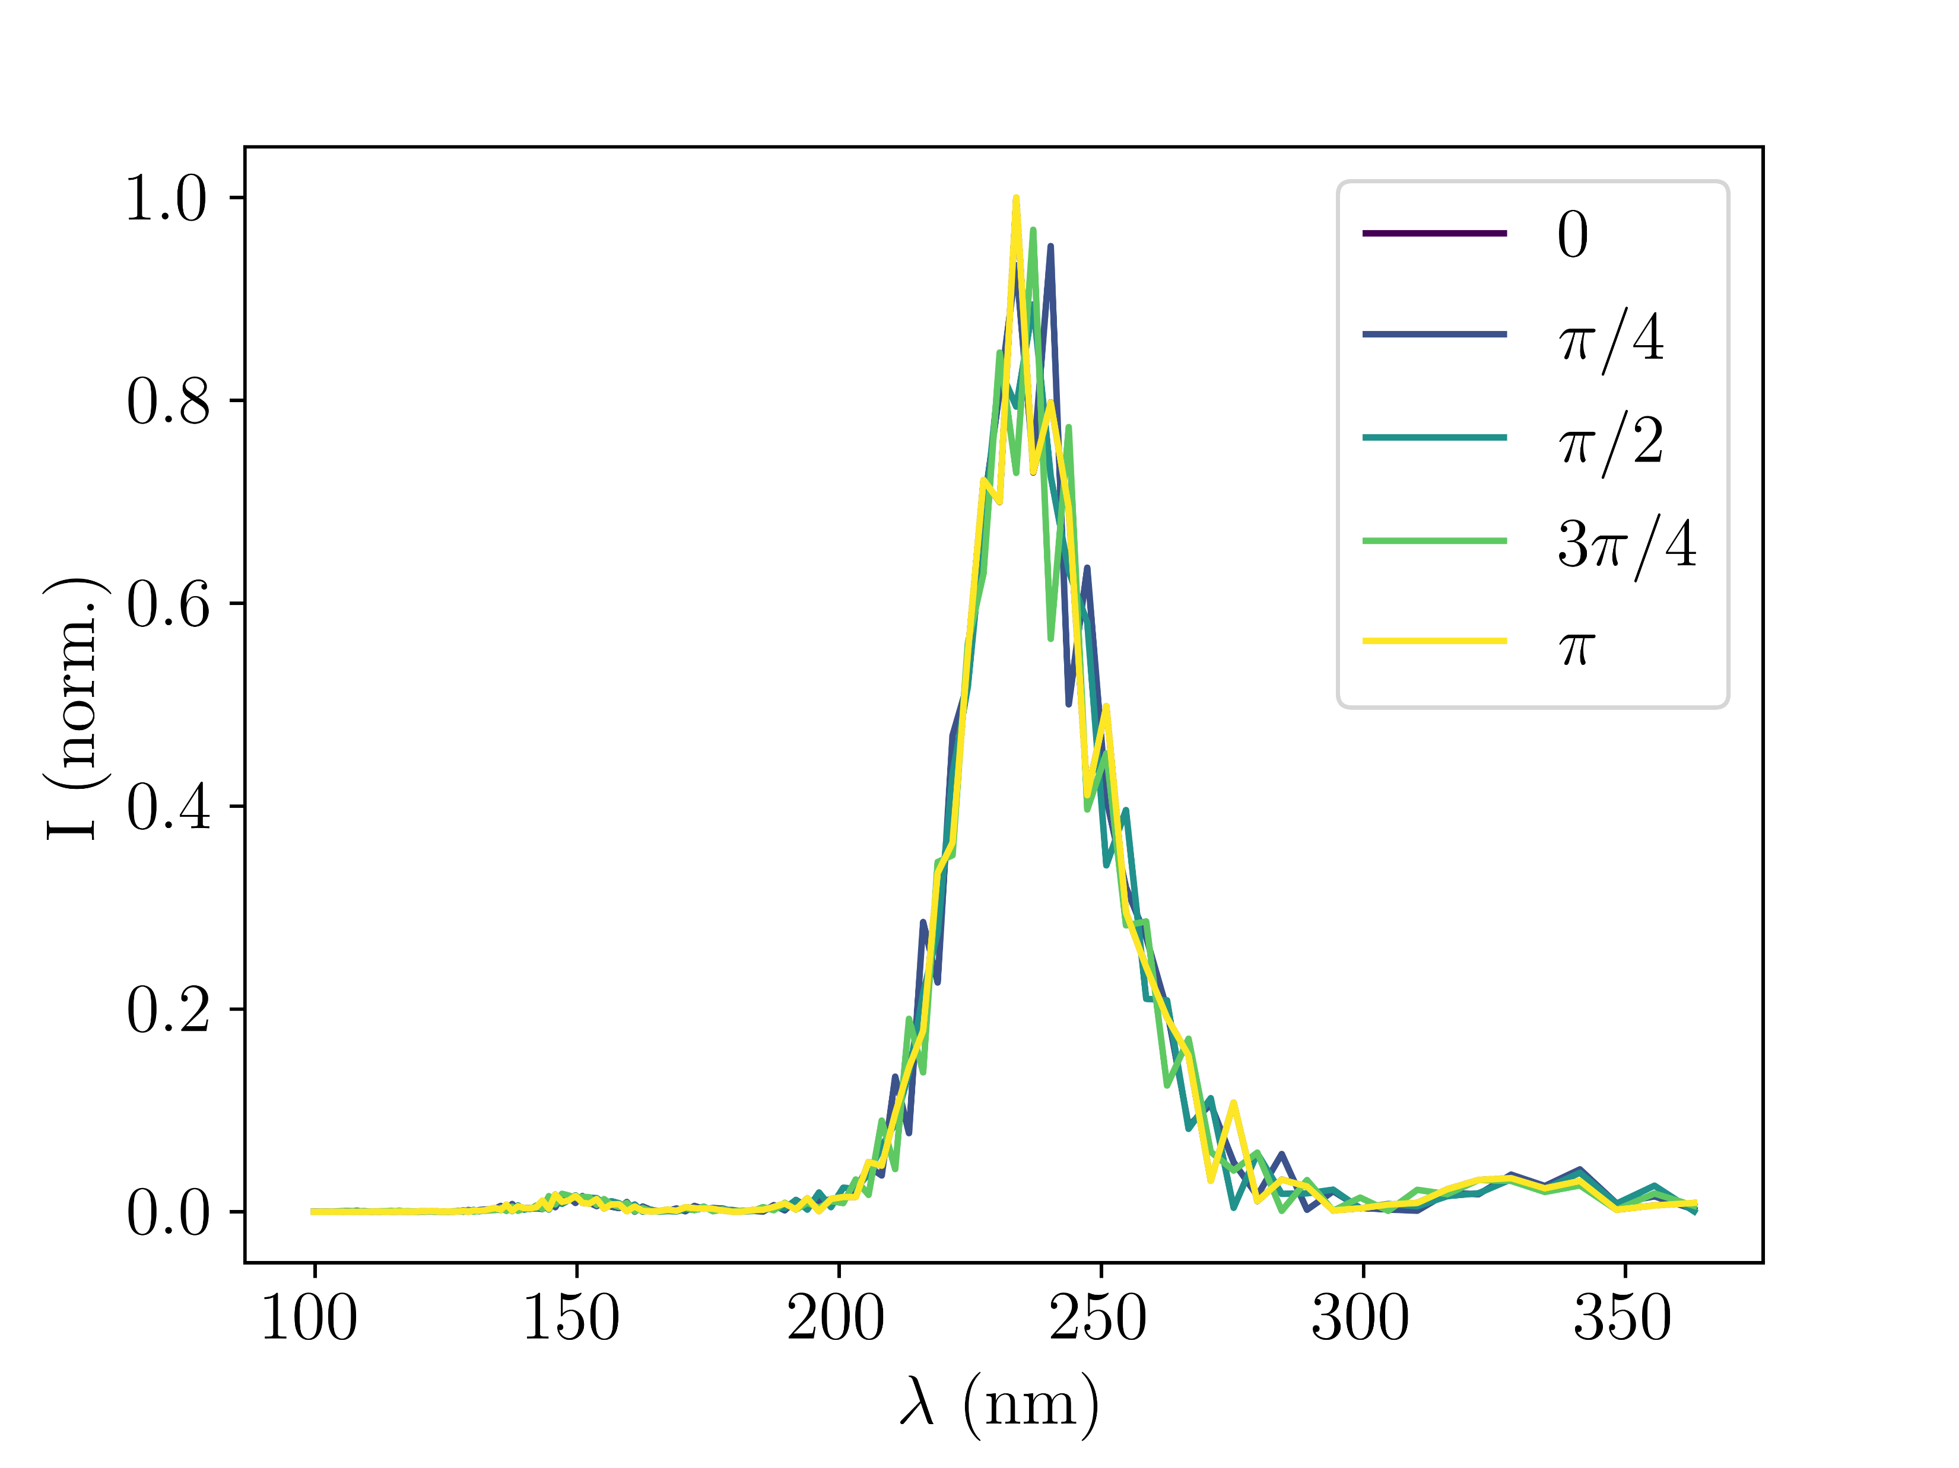
Sample manuscript plots: G. Effects of CEP
Fig. 7: Argon at 150mW and 0.4bar with different CEP values of the input pulse (simulations with
gradient model)

Slide 10
Sample manuscript plots: H. Comparison of 10 best spectra
no time yet
Note: is it even worth it?
Fig. 8: ….

Slide 11
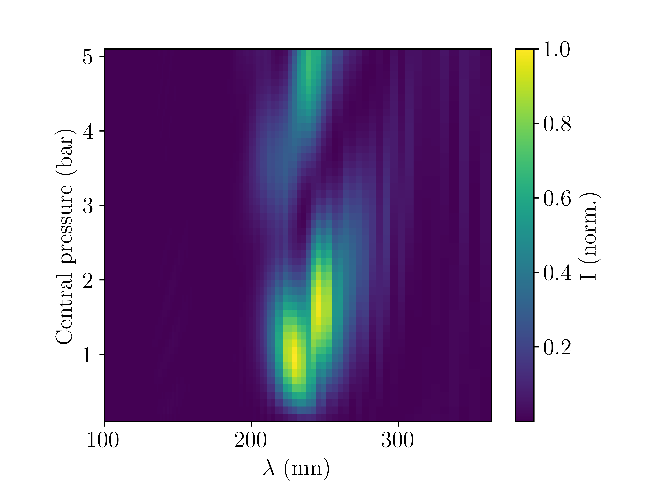
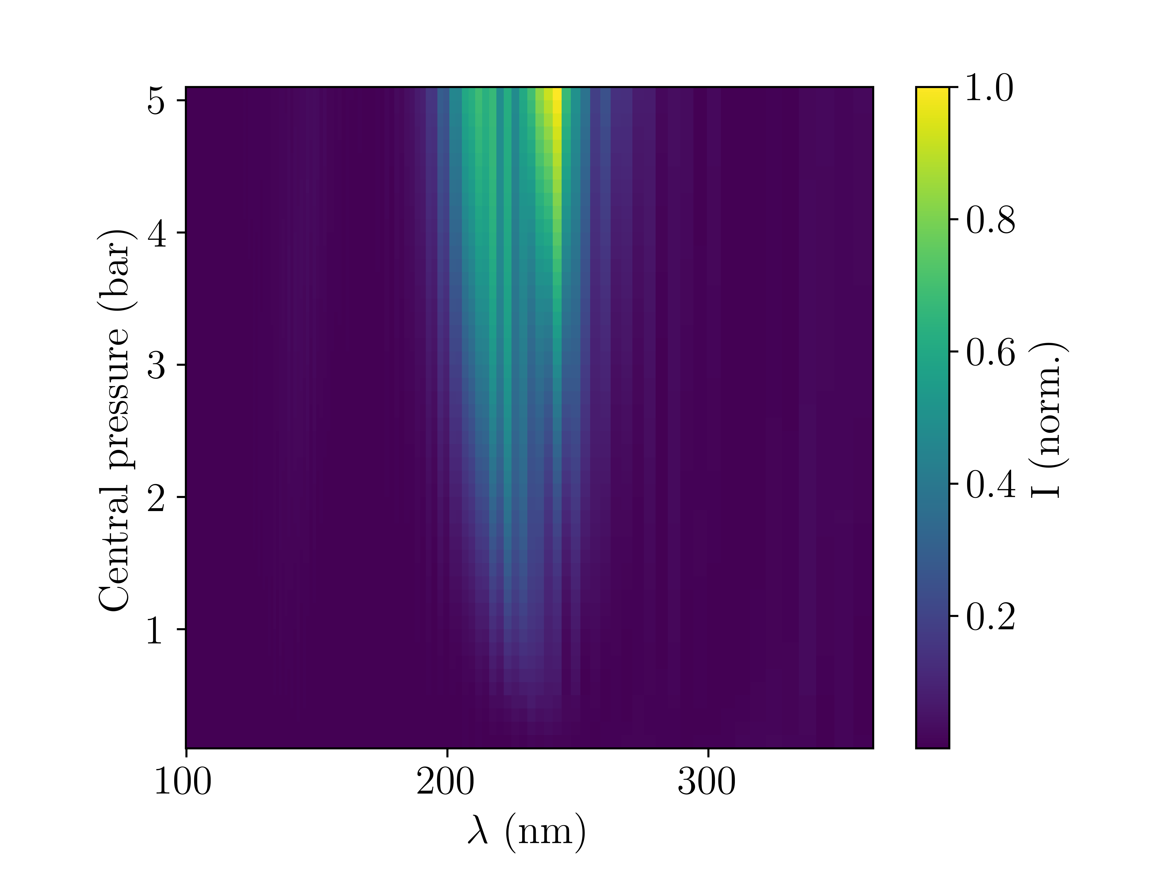
Sample manuscript plots: I. New: 2d maps
Fig. 9a: Argon at 150mW (simulations with
gradient model)
Fig. 9b: Neon at 400mW (simulations with
gradient model)

Slide 12
Sample manuscript plots: I. New: 2d maps
no time yet
no time yet
Fig. 9c: Argon at 150mW (measured)
Fig. 9d: Neon at 400mW (measured)

Slide 13
Questions
Feedback for plots?
Where to find images of old and new gas cell/chip (for report and presentation)?

